Slide 1
CANADIAN PARENTS FOR FRENCH (ONTARIO)
2
+
2
+
MARKETING: CREATIVE AND REPORTING

Slide 2
2
+
TABLE OF CONTENTS
01
Creative: Marketing Collaterals
Reporting: Key Performance Indicators
02

Slide 3
2
+
2
+
2
+
CREATIVE

Slide 4
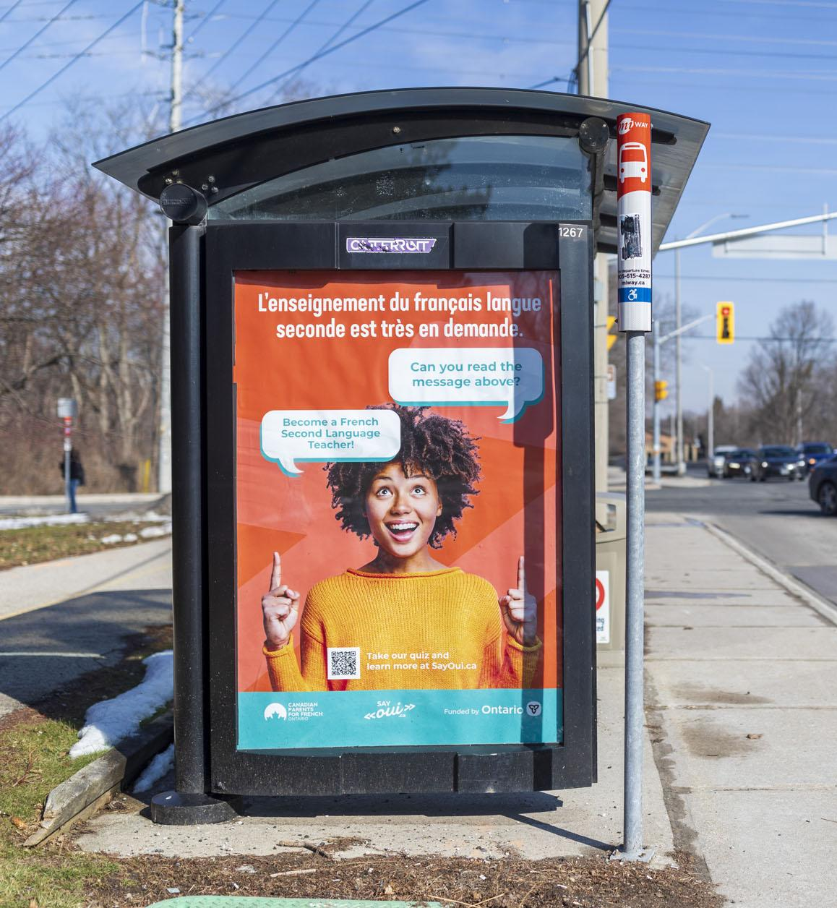
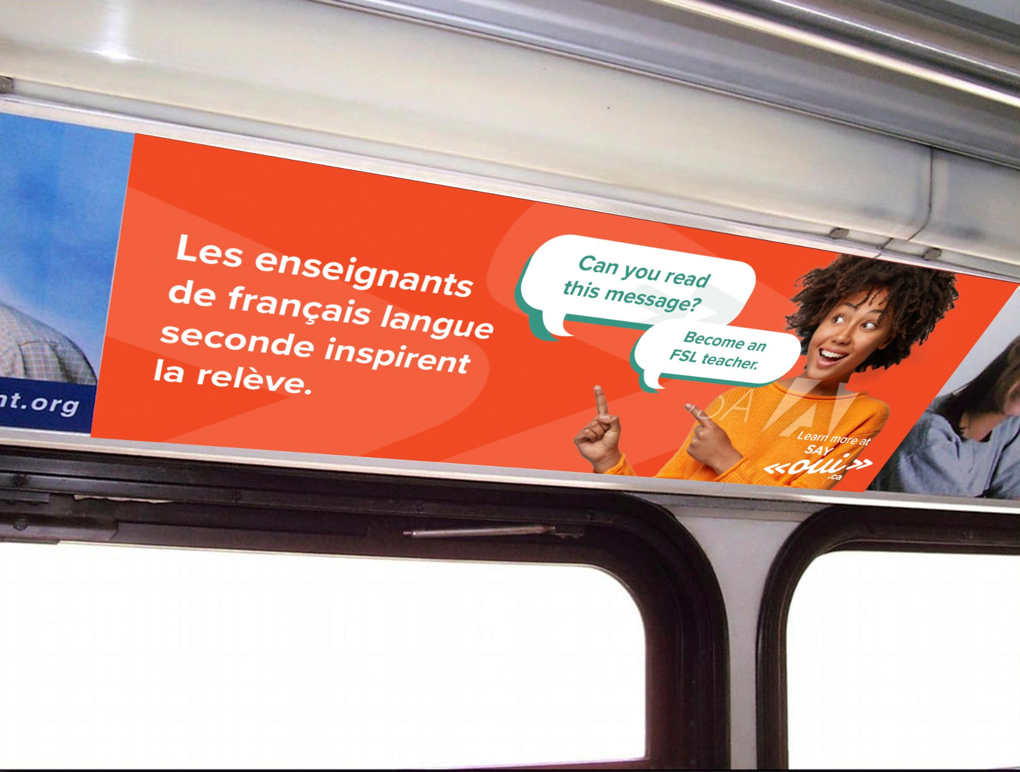
BUS SIGNAGE
CPF Ontario worked with US Communications to develop a marketing strategy for our bus shelter and indoor signage campaigns.
We ran ads in Toronto, Ottawa, and Mississauga, targeting FSL post-secondary institutions and student populations.

Slide 5
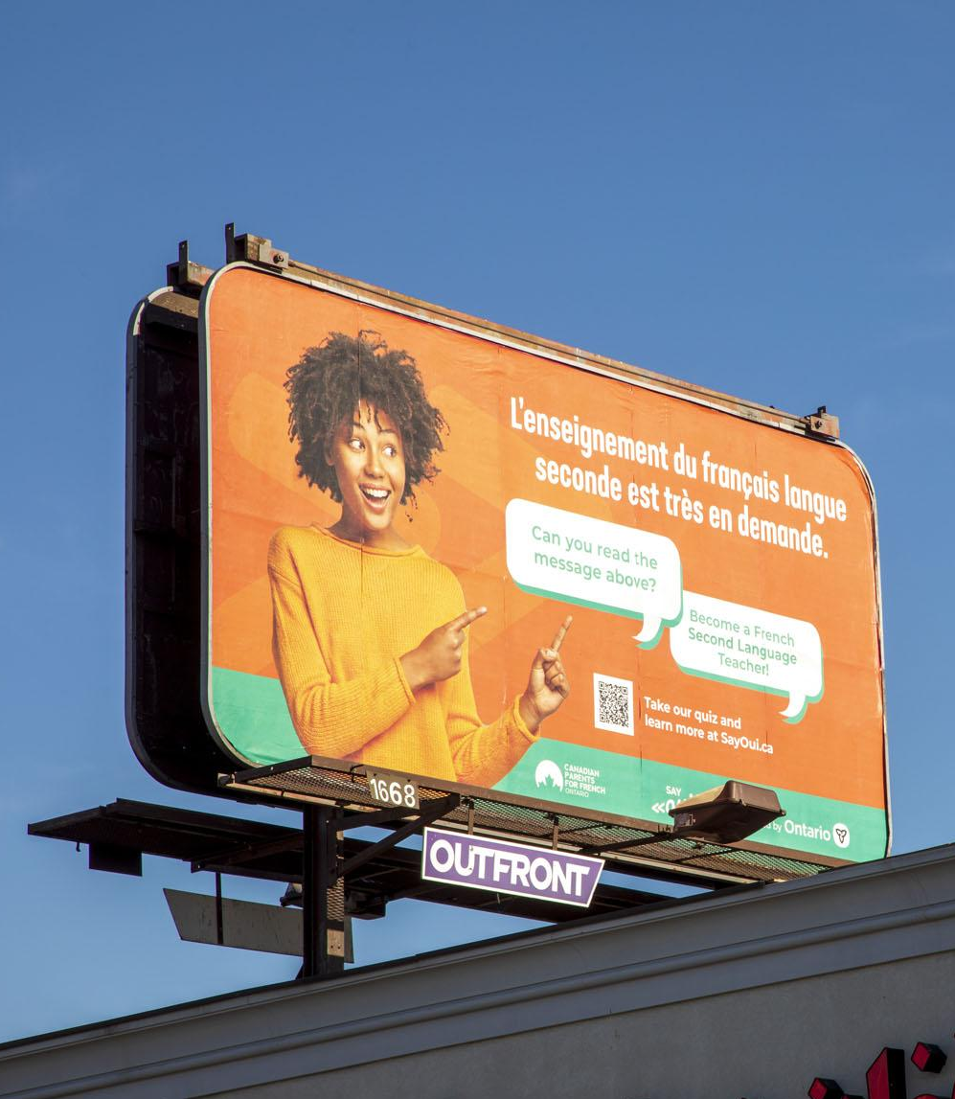
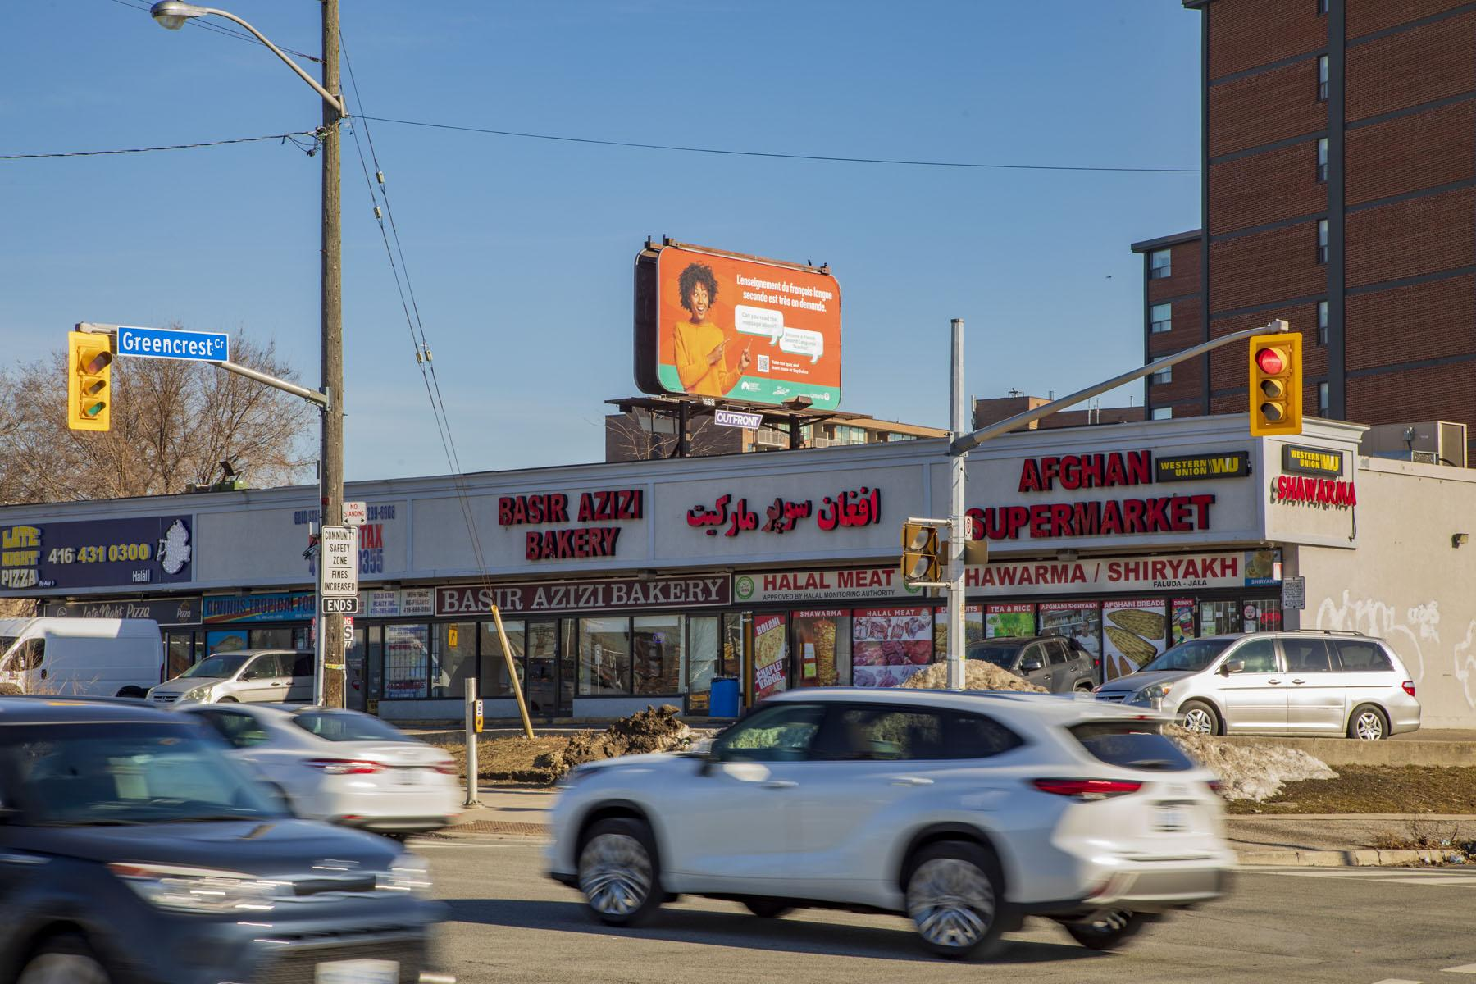

Slide 6
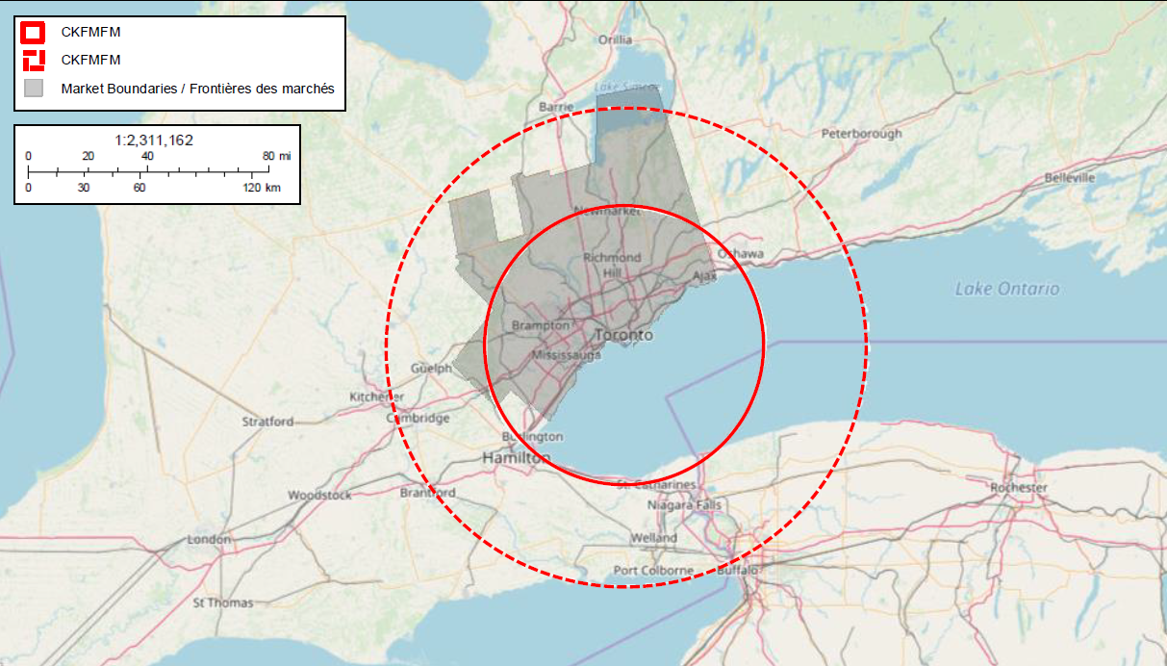
RADIO ADVERTISEMENT
CPF Ontario worked with Bell Media to run a radio advertising campaign from October 17 - December 4.
We targeted parents of high school and college students by advertising on Newstalk1010.
VIRGIN RADIO
Demographic: 25-34 with a brand appeal to women 18-49.
Average Household income: 70k per year.
Listeners: 1.6 Million Per week
Average Time Spent Listening: 4.4 hours per day
NEWSTALK 1010
Demographic: 35-64 with a brand appeal to 35-64
Listeners: 650k Per week.
Average Household income: 95k+ per year.
Average Time Spent Listening: 6 hours per day

Slide 7
ORGANIC SOCIAL MEDIA STRATEGY
CPF Ontario ran several social campaigns on our Facebook and Twitter accounts from November to March.
.

Slide 8
ORGANIC SOCIAL MEDIA STRATEGY, continued:
CPF Ontario promoted the SayOUI.ca website through our partner social networks from January to March, 2023.
.

Slide 9
2
+
2
+
REPORTING:
KEY PERFORMANCE INDICATORS

Slide 10
FACEBOOK PAID AD CAMPAIGNS
CPF Ontario ran two campaigns targeting French-speaking students on our Facebook and Instagram accounts from November to March.
.
Campaign | Cost | Impressions | Reach | Clicks | CTR | CPC
November 6 | $1,327 | 155,682 | 35,928 | 774 | 2.15% | $1.71
December 2 | $1,999 | 164,923 | 39,918 | 824 | 2.06% | $2.43
CPF Ontario ran two Facebook campaigns during the months of November and December. These ads targeted people between the ages of 18 - 44 that speak French in Ontario and how have an interest in University, Employment, College, Student, French language or Travel.
These ads included articles with information about the resources offered on the SayOUI.ca website.
While these campaigns were much more expensive than TikTok at an average cost-per-click of $2, they allowed us to better target students that were relevant to our campaign.
These ad campaigns also ran on Instagram, as part of Facebook’s Meta platform, and analytics include both Facebook and Instagram results.

Slide 11
TIKTOK PAID AD CAMPAIGNS
CPF Ontario ran two campaigns targeting French-speaking students on our Facebook and Instagram accounts from November to March.
Analytics continued on next page.
.
Campaign | Cost | Impressions | Reach | Clicks | CTR | CPC
November 11 | $7,460 | 6,678, 567 | n/a | 514,750 | 7.7% | $0.08
CPF Ontario ran a TikTok campaign in November through March promoting the SayOUI.ca website through our ‘Gaston the French Bulldog” campaign.
The ad targeted people living in Ontario and was most viewed by 18-35 year olds.
CPF Ontario reduced cost-per-click from $0.30 to $0.2 by optimizing ad display, and TikTok was able to further reduce cost-per-click to $0.08 through their algorithm.
While TikTok generated a vast quantity of impressions and clicks, many people who clicked on the ad didn’t wait for the web page to load, indicating an unengaged or irrelevant audience. Unlike Facebook, TikTok doesn’t allow detailed targeting. Nonetheless, TikTok was a cost-effective and effective medium for spreading awareness of the shortage of FSL teachers in Ontario and the resources available on the SayOUI.ca website.

Slide 12
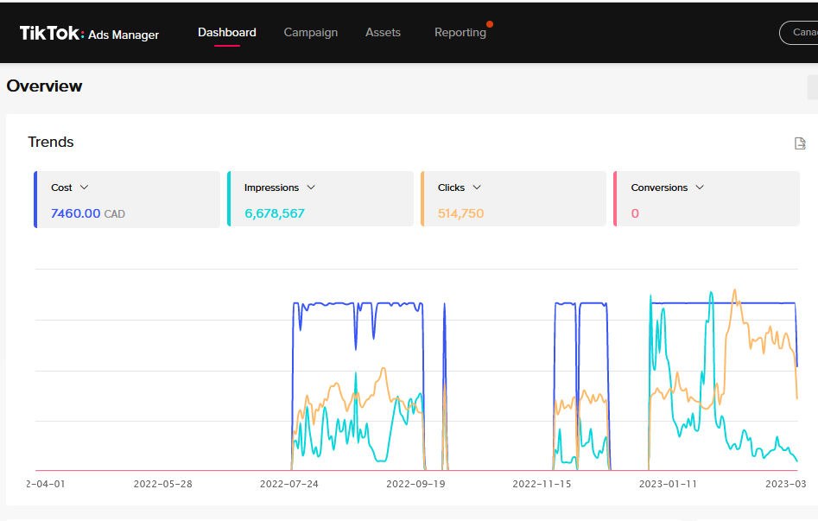

Slide 13
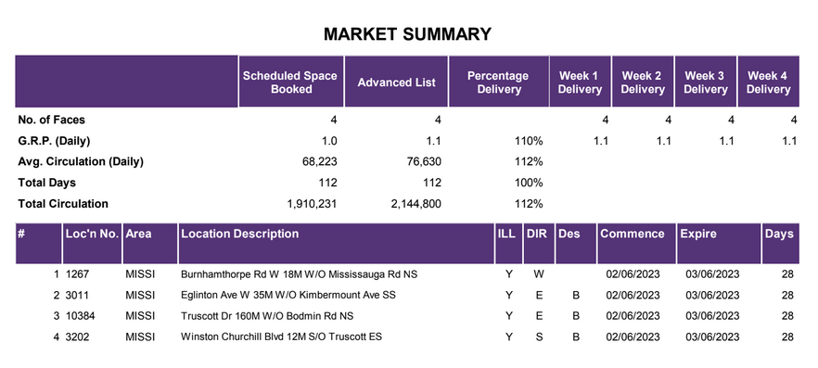
BUS INTERIOR AND BUS SHELTER SIGNAGE CAMPAIGNS
CPF Ontario ran two bus interior and shelter ad campaigns.
Our Toronto and Ottawa bus shelter and bus interior signage campaign ran from January 9 to February 6 and reached a circulation of 2,334,220.
Our Mississauga bus shelter signage campaign ran from February 6 to March 6 and targeted locations frequented by FSL students, including the University of Toronto, Mississauga campus. This campaign reached a circulation of 2,144,800.
.

Slide 14
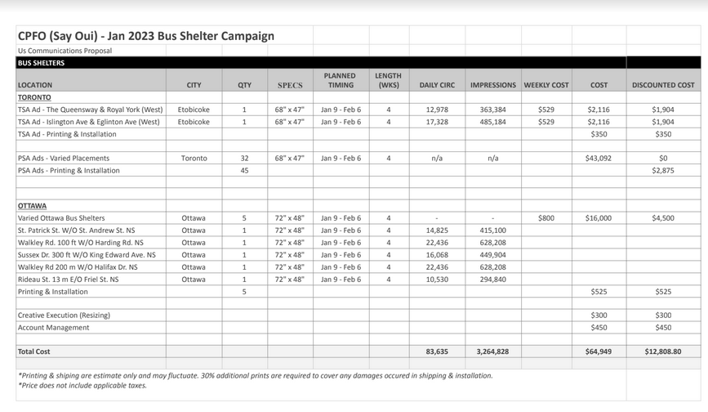

Slide 15
CONCLUSION
In the second half of Phase 3, CPF Ontario allocated our digital marketing budget towards Facebook and TikTok ad campaigns. Facebook offers detailed targeting to reach audiences such as teachers, parents and students at an affordable price, generating 320,605 impressions, while TikTok allowed us to reach a wide audience with a great return on investment, generating 6,578,567 impressions.
This year we expanded our previous year bus signage campaign to include Ottawa, Toronto and Mississauga, reaching a circulation of 2,144,800 in Mississauga and 2,334,220 in Toronto and Ottawa. Bus signage campaigns were the most effective of our traditional advertising channels, because they allowed us to target student traffic-heavy areas such as schools with FSL programs.
Our total audience reached from October 15 - March 15 was 16,023,192, and in Phase 3, our digital and traditional campaigns helped drive 146,000 unique visitors to our website.
Channel | Circulation/Impressions
Facebook | 320,605
TikTok | 6,678,567
Radio Advertisement | 4,550,000
Bus Signage - Ottawa and Toronto | 2,334,220
Bus Signage - Mississauga | 2,144,800
TOTAL | 16,028,192
TOTAL Social Media | 6,999,172
TOTAL Signage | 9,029,020

Slide 16
THANK YOU!
2
+
2
+

